Slide 1
NFT MARKETPLACE
TEAM MEMBERS:
Nishanth G
Yogeshwaran V
Nelson G
Prasanaa Venkatesh D

Slide 2
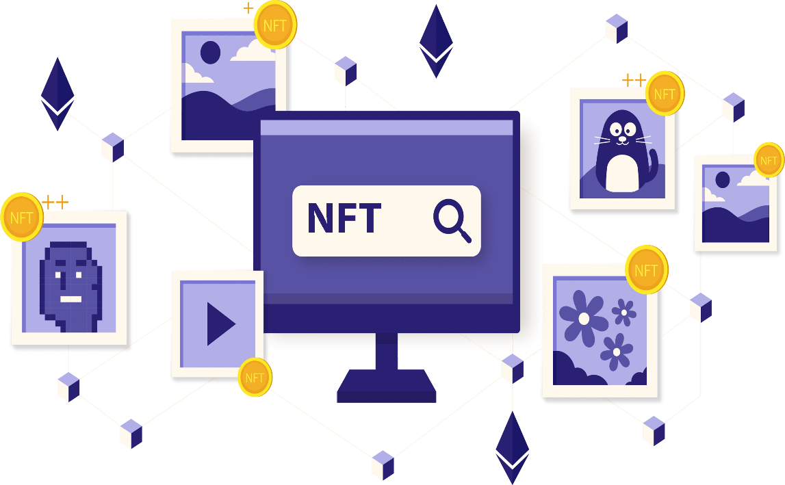
ABSTRACT
In recent years, the term "Non-Fungible Tokens" has gained popularity. On the other side, there are now very few people on-chain, and the great majority of NFTs are exclusively available on-chain.
Nowadays, fewer than 1% of people worldwide utilise crypto wallets. As a result, there is currently a need for solutions to make it easier for those who are not familiar with on-chain wallets to buy and sell NFTs.
For this problem we are developing a NFT token exchange platform which is user friendly.

Slide 3

PROBLEM STATEMENT
NFT (Non-Fungible Tokens) has become a buzzword in recent years and is gaining traction. However, the vast majority of NFTs are currently only available on-chain, on the other hand, the number of people on-chain is very small. Today, crypto wallets are used by less than 1% of the world's population. As a result, solutions to simplify the ways NFTs are bought and sold for people unfamiliar with on-chain wallets are currently in demand.

Slide 4
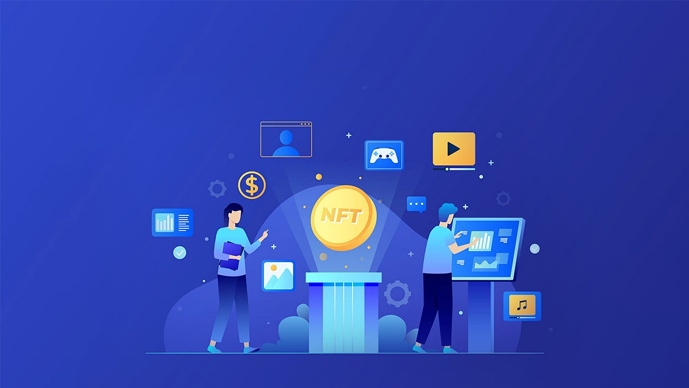
PROPOSED WORK
Develop an NFT trading platform with the best possible customer experience. NFTs are a global phenomenon, catering to crypto-enthusiasts and non-crypto-native consumers, so the platform should allow people to easily buy and sell NFTs with both crypto and traditional payment methods.

Slide 5
WHAT IS NFT?
NFT stands for non-fungible token. An NFT transforms a digital file ( Image, Audio, gif, Video, PDF) into a digital asset.
An NFT token is created and stored on a blockchain, serving as proof of ownership and provenance of a specific item.
It works like a digital certificate of authenticity that can be easily verified by anyone anywhere in the world on a blockchain.
WHAT IS NFT MARKETPLACE ?
An NFT marketplace is a digital platform for buying and selling NFTs. These platforms allow people to store and display their NFTs plus sell them to others for cryptocurrency or money.

Slide 6
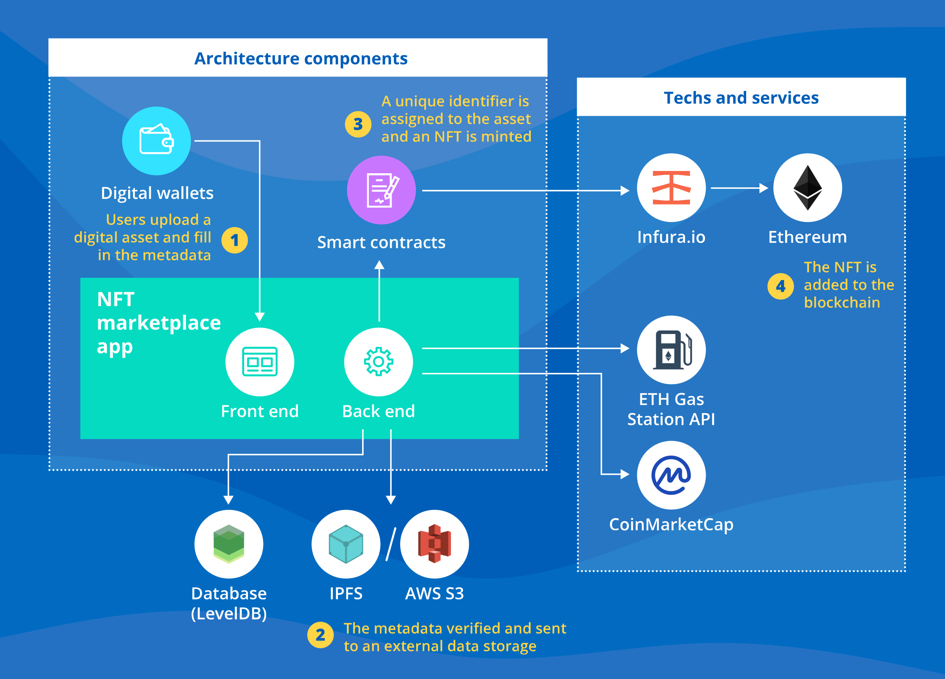

Slide 7
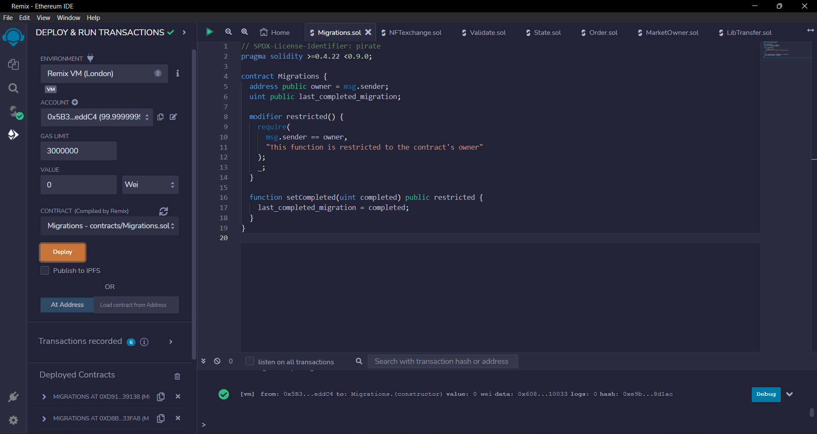

Slide 8
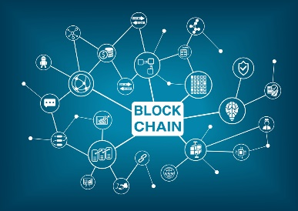


TECHNOLOGY USED
BLOCKCHAIN
SOLIDITY
JSON

Slide 9
THANK YOU

